Slide 1
SUPPLY CHAIN ANALYSIS
PRESENTED BY:
PRAJWAL R PATIL
CERTIFIED DATA ANALYST (CDA-JAN-05)
REGISTER NO: CA12202540402

Slide 2
Introduction
Supply Chain Management plays a critical role in ensuring the smooth flow of products from suppliers to customers. Effective supply chain operations help organizations reduce costs, improve product availability, enhance customer satisfaction, and increase overall profitability.
This project focuses on analyzing various aspects of the supply chain, including inventory management, supplier performance, manufacturing efficiency, logistics operations, and product quality. Using Power BI, an interactive dashboard was developed to transform raw supply chain data into meaningful insights.
The dashboard enables stakeholders to monitor key performance indicators (KPIs), identify operational bottlenecks, evaluate product performance, and make data-driven decisions to improve supply chain efficiency and business performance.

Slide 3
Project Overview
The Supply Chain Analysis Project is designed to analyze and monitor the end-to-end supply chain operations of a company. The project focuses on key business areas such as inventory management, demand forecasting, supplier performance, manufacturing efficiency, logistics operations, and product quality.
Using Power BI, interactive dashboards were developed to transform raw supply chain data into meaningful insights. The analysis helps identify operational bottlenecks, reduce costs, improve inventory utilization, optimize transportation performance, and enhance product quality.
The dataset contains information related to products, stock levels, sales, suppliers, manufacturing costs, shipping details, transportation modes, and defect rates. By analyzing these factors, the dashboard enables management to make data-driven decisions and improve overall supply chain performance.

Slide 4
Objectives
Monitor inventory and demand.
Evaluate supplier and manufacturing performance.
Analyze logistics and transportation efficiency.
Measure product quality and defect rates.
Compare product performance and profitability.
Support data-driven decision-making.
Improve overall supply chain efficiency.

Slide 5
Motivation for Choosing the Dataset
Supply chain management is a critical function that directly impacts business performance, customer satisfaction, and profitability.
The dataset contains real-world supply chain metrics such as inventory levels, supplier information, manufacturing costs, shipping details, and product quality data.
It provides an opportunity to analyze multiple business operations within a single project.
The dataset helps in understanding how inventory, suppliers, logistics, and product quality influence overall supply chain efficiency.
It is suitable for applying data analytics and visualization techniques using Power BI.
The project enables the identification of operational bottlenecks and supports data-driven decision-making.

Slide 6
Dashboard Overview
The Supply Chain Analysis Dashboard is an interactive Power BI solution designed to provide a complete view of supply chain operations. It consolidates data related to inventory, suppliers, manufacturing, logistics, and product quality into a single platform for easy monitoring and analysis.
The dashboard helps stakeholders track key performance indicators (KPIs), identify operational bottlenecks, evaluate product performance, and make data-driven decisions. By visualizing critical supply chain metrics, the dashboard enables organizations to improve efficiency, reduce costs, optimize inventory levels, and enhance overall business performance.

Slide 7
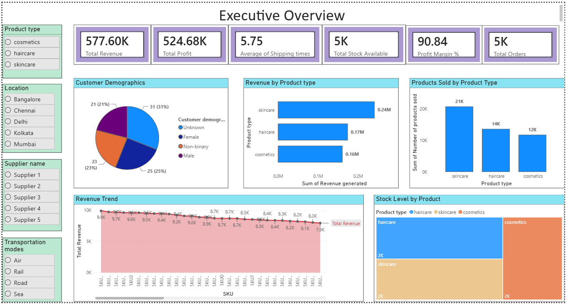
Executive Overview

Slide 8
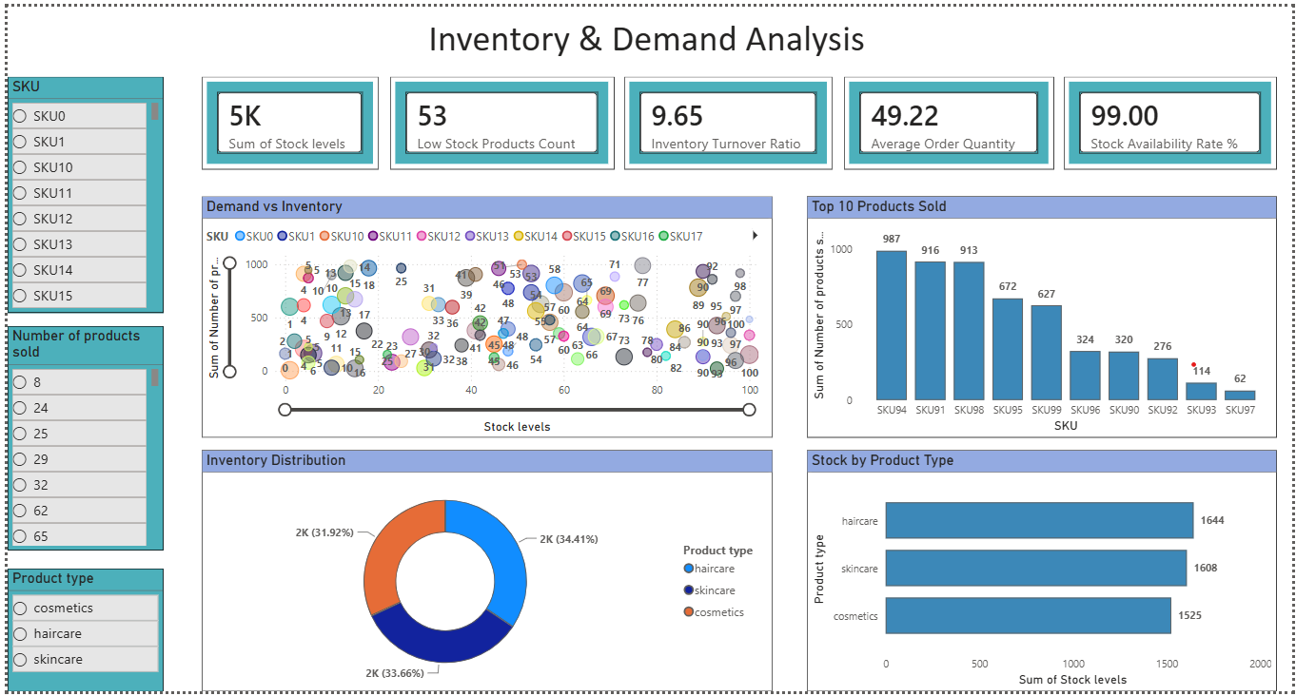
Inventory & Demand Analysis

Slide 9
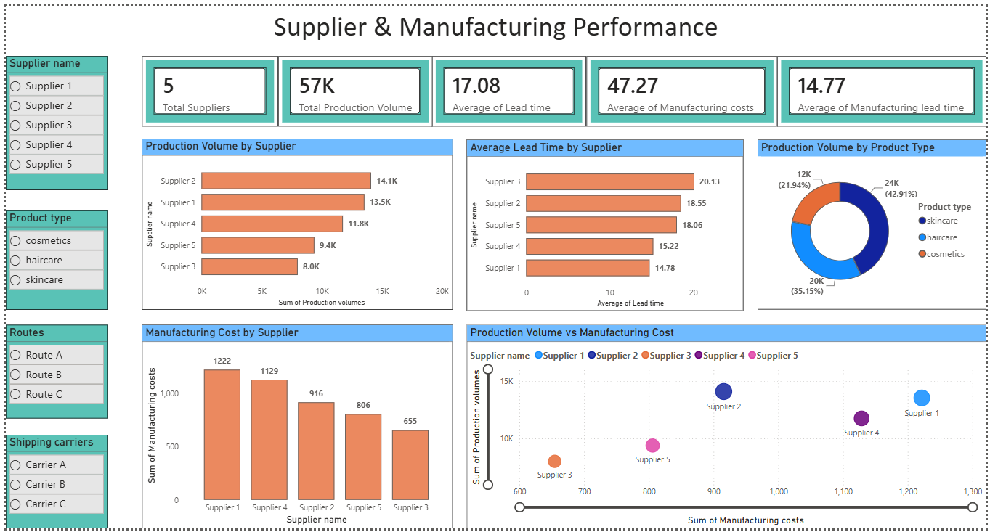
Supplier & Manufacturing Performance

Slide 10
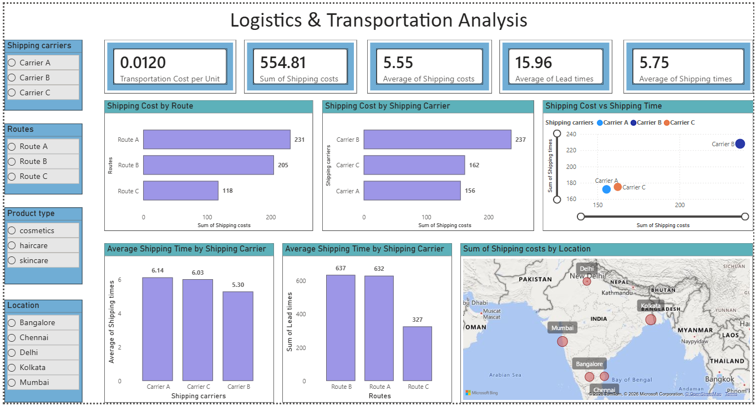
Logistics & Transportation Analysis

Slide 11
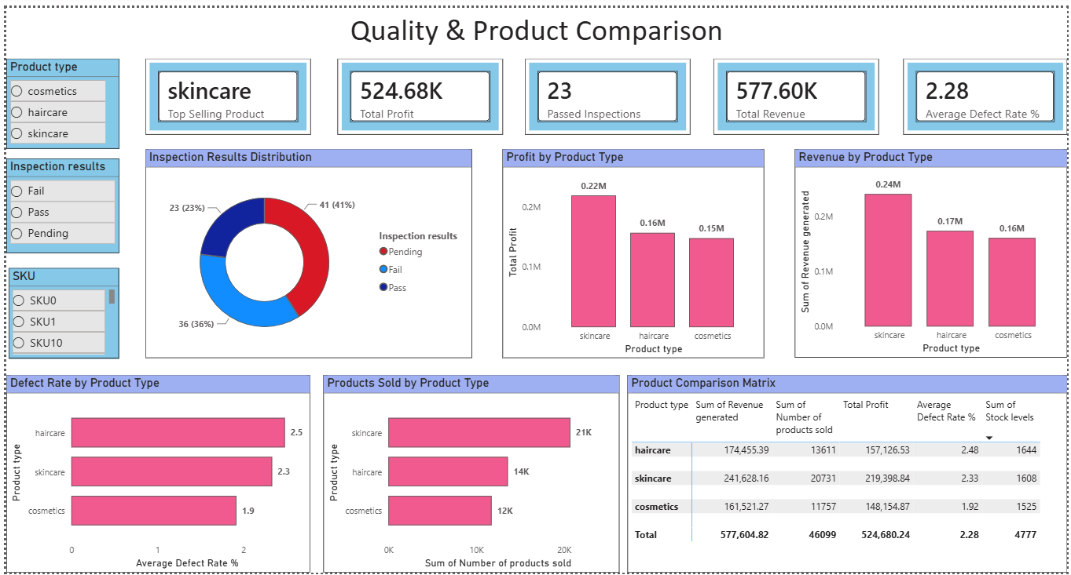
Quality & Product comparison

Slide 12
Methodology
Data Collection – Gathered supply chain dataset.
Data Cleaning – Removed errors, duplicates, and missing values.
Data Transformation – Created KPIs and measures using DAX.
Data Analysis – Analyzed inventory, suppliers, logistics, and quality.
Dashboard Development – Built interactive Power BI dashboards.
Insights & Recommendations – Identified trends and suggested improvements.

Slide 13
Recommendations
Maintain optimal inventory levels to avoid stock shortages and overstocking.
Implement safety stock planning for high-demand products.
Monitor supplier performance regularly and reduce lead time delays.
Optimize transportation routes and shipping methods to lower logistics costs.
Focus on high-performing products to maximize revenue and profitability.
Strengthen quality control processes to reduce defect rates.

Slide 14
Conclusion
The Supply Chain Analysis Dashboard provides a comprehensive view of inventory, supplier performance, manufacturing efficiency, logistics operations, and product quality. By analyzing key performance indicators and business metrics, the dashboard helps identify operational bottlenecks, improve resource utilization, and support data-driven decision-making.

Slide 15
Thank You

